Slide 1
Queue

Slide 2
Queue Abstract Datatype
It is a sequence of objects collected into a queue with a First-in First Out (FIFO) discipline
Operations:
enqueue: add an object to the end of the queue
dequeue: remove an object from the front of the queue

Slide 3



Queue using a static array

Slide 4


Slide 5



Slide 8



Slide 10
Enqueue – O(1) operation
Dequeue – O(n) operation

Slide 11




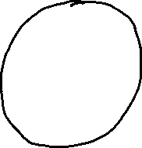
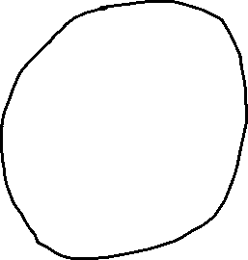
Static Array in a Circular Arrangement

Slide 12
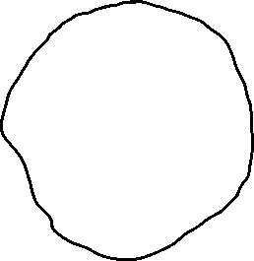


Slide 13


Slide 14


Slide 15


Slide 16



Slide 17



Slide 18


Slide 19



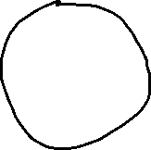




Slide 22
Enqueue O(1)
Dequeue O(1)

Slide 23


Queue using a linked data structure

Slide 24




Slide 25



Slide 26



Slide 27


Slide 28



Slide 29


